Slide 1
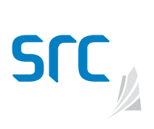
Centre for the Demonstration of Emissions Reductions (CeDER)
Presented by
Erica Emery, Senior Research Engineer
Saskatchewan Research Council
September 24, 2020

Slide 2
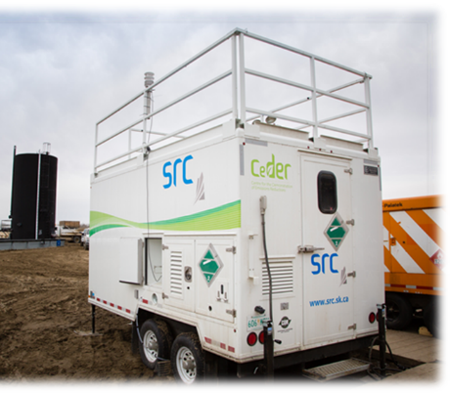
Saskatchewan Research Council (SRC)
Canada’s second largest research and technology organization
Treasury Board Crown Corporation
Operates on a fee-for-service basis for the application of smart science solutions and services for the industries that we serve
Focused on real-world industry needs
World-class laboratories and facilities in Saskatoon and Regina
Centre for the Demonstration of Emissions Reductions (CeDER)

Slide 3
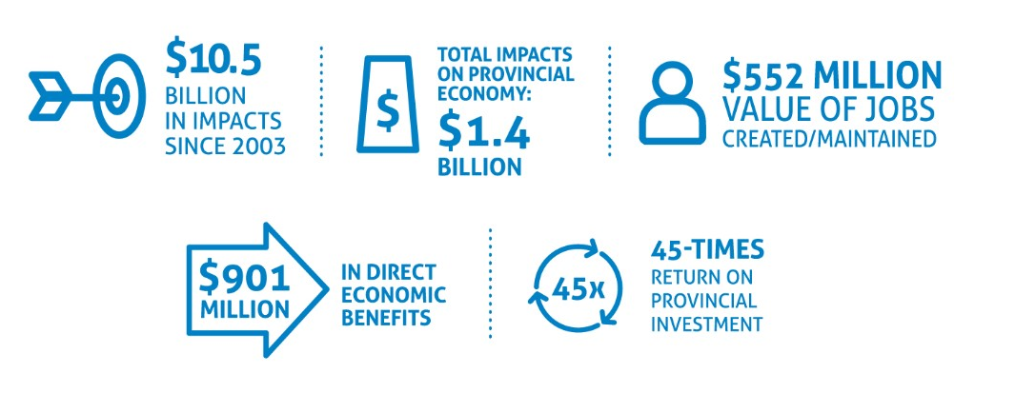
SRC Core Values
Our Economic Impacts in 2019-2020
Integrity: We deal with people and organizations honestly and ethically.
Respect: We treat people, property and the environment with respect.
Quality: We deliver quality to clients and colleagues.
One Team: We work together in the best interests of SRC.

Slide 4
Corporate Capacity
Environment - Air and climate monitoring and assessment, environmental site remediation management and oversight, consulting and environmental analytical services.
Energy - Enhanced oil recovery technologies, partial upgrading, and catalyst testing technologies, greenhouse gas reduction
Mining and Minerals - Exploration support, process development, tailings transportation and analytical services; we work on multiphase flow, process testing and demonstration, and pipeline design and development for the mineral and petroleum industries.
Agriculture and Biotechnology - Broad portfolio of services to support a sustainable agriculture industry in Canada.

Slide 5
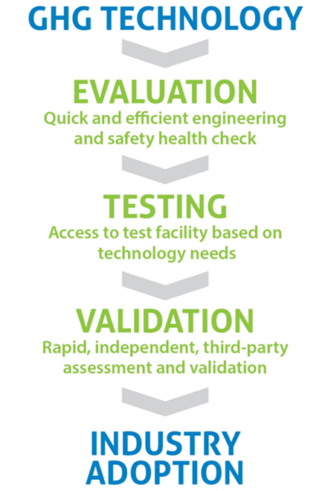
The CeDER platform consists of a range of services and capabilities for industry:
SRC’s technology assessment and validation process:
Technology selection
Database of over 400 GHG emissions reduction technologies
Techno-economic assessment
Real-world technology performance and emissions testing
Validation protocol
Lab, pilot, and commercial scale
Mobile field facilities
Notes:
Less a fixed facility than a suite of expert services and capabilities
60% oil and gas and these include methane c and c, CO2 C and C, and allow searching and comparison on mitigation cost, TRL, inputs, out outs be it power, methanol, CNG,
Filtering the most promising technologies based on requirements.
SRC uses our own standardized validation protocol to ensure quality, transparency, and consistency of the validation process for all clients.

Slide 6
Technology Assessment
Database of GHG Emissions Reduction Technologies with information on nearly 400 emissions reduction technologies applicable to a wide range of industries (e.g., oil and gas, mining, agriculture, power generation)
Technology options - create list and screen results based on client inputs
Economic assessment - perform economic analysis
Implementation assessment – assess technology for practical field implementation considerations for the target application
Environmental assessment - GHG verification and life cycle assessment
Full-scale or pilot performance testing in the field using mobile facilities

Slide 7
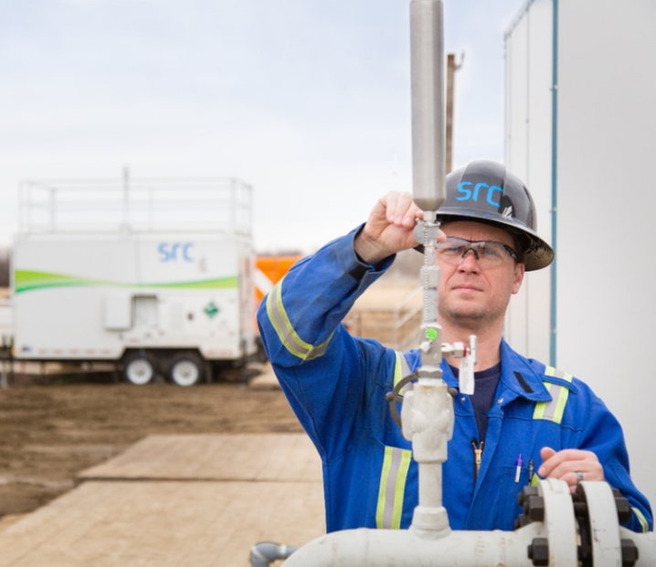
CeDER Mobile Facilities
Credible, fee-for-service, low-cost platform for field-scale testing of emissions reduction and capture technologies
Real-world testing, demonstration and validation of GHG emissions reduction technologies
Independent, third-party validation
Utilizes standardized validation protocol to ensure quality, transparency and consistency of the validation process
Accelerates industry adoption of practical emissions reduction technologies
CeDER’s trailers move easily between locations; while based in Saskatchewan, operate in field locations across Canada

Slide 8
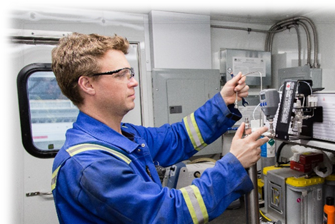
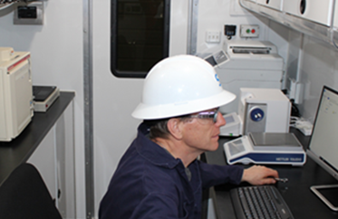
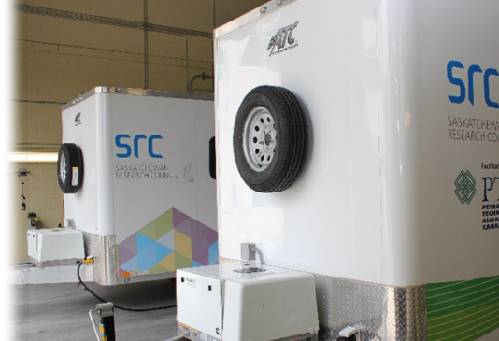
Mobile Facilities
CeDER mobile facilities are:
Modular – provide a wide range of testing for diverse technology scenarios
Operated by experienced field and technical personnel
Designed to monitor, measure and validate:
Mass-energy inputs and outputs
Internal and nearby gas emissions
Use wireless sensors – industry standard instrumentation
Notes:
meaning that the instrumentation and equipment required for each project can be mobilized as needed.

Slide 9
CeDER can assess and validate technologies geared to
Measurement
Prevention
Capture
Conversion
Low and high-volume sources
Capabilities include:
Methane (CH₄)
Carbon dioxide (CO₂)
Hydrogen sulfide (H₂S)
Mono-nitrogen oxides (NOx)
Sulfur oxides (SOx)
Notes:
Most GHG emissions capture and conversion technologies can be tested, demonstrated, and validated safely.

Slide 10
CeDER is equipped to test and validate most types of emissions measurement and reductions systems
Flare/Combustion | Capture/Conversion | Emission Monitoring Systems
Utility and Smokeless Flares | Vapour Recovery (CNG/LNG/NGL) | Static and Mobile Systems
Electronic Ignition Flares | Gas-To-Liquids (DME, NH₃) | UAV Systems
Incinerators | Gas-to-Power | QOGI Systems
Catalytic Oxidizers | Methane to CO₂ via Bio-Conversion | LDAR Programs
Notes:
DME = dimethyl ether, NH3 = ammonia

Slide 11
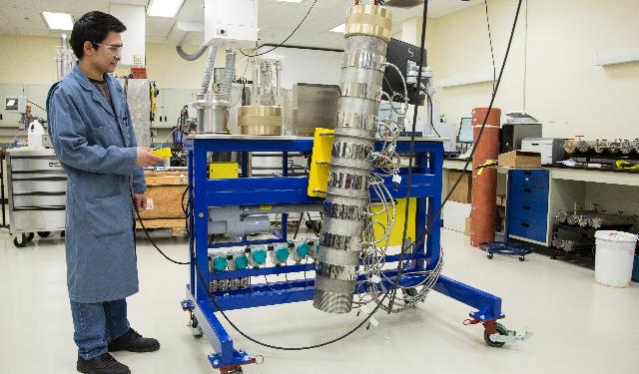
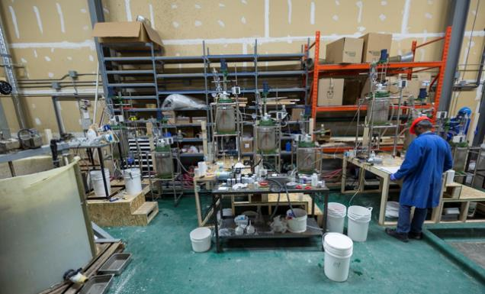
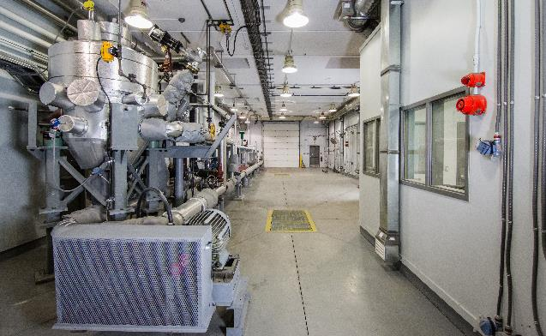
SRC Facilities
SRC has a number of well-equipped facilities that complement CeDER’s mobile field testing:
Bench-scale Labs
Pilot Plant Areas
Shook-Gillies HPHT Test Facility
Explosion-Proof Building
Volatile Fluids
High Pressure High Temperature 4-inch Diameter Loop

Slide 12
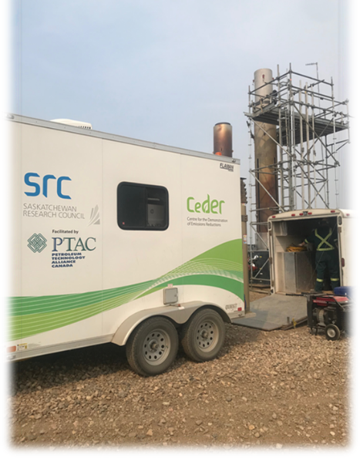
CeDER and CanERIC
CeDER pre-dates CanERIC, trailers are already operating in the field
SRC to receive NRCAN funding for equipment needed to expand capacity for CanERIC projects
CeDER provides the ability to test technologies in real world installations
Compliments fixed facilities provided elsewhere in CERIN network
SRC has laboratory test capacity, along with other members of the Infrastructure Steering Committee (AI, CMC, SAIT, Universities)

Slide 13
Saskatchewan Government Support
Government of Saskatchewan investing up to $400,000 towards SRC activities under CanERIC as part of its Methane Action Plan
Provided by Innovation Saskatchewan and Saskatchewan Ministry of Energy and Resources (50/50)
Contributions are to SRC for testing, validating and accelerating adoption rates for a range of methane emission reduction technologies under CanERIC
To cover up to 20% of activities under CanERIC involving SRC’s services
Remaining funds (80%) must be leveraged from CanERIC funding and other program participants.

Slide 14
Let’s Collaborate!
SRC has both laboratory and mobile field facilities
Experienced engineers, scientists, and technologists
Can draw on expertise throughout SRC (in energy, mining, advanced manufacturing and environment)
Work with industrial clients, academic institutions, regulators and government, inventors and investors

Slide 15
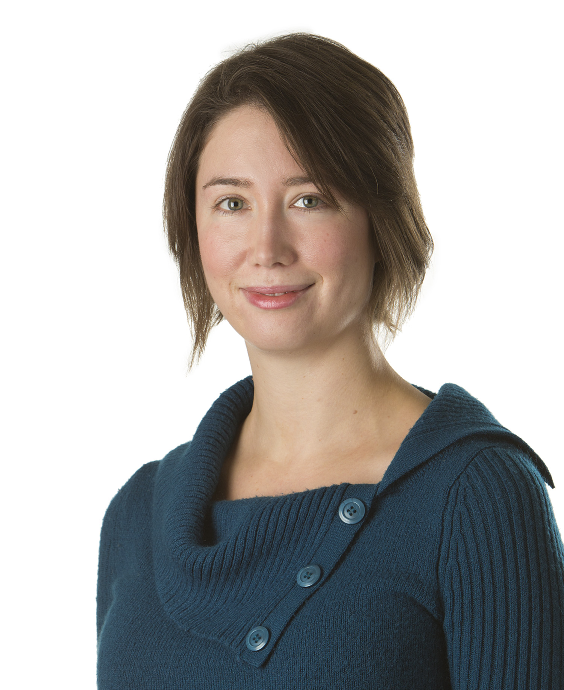
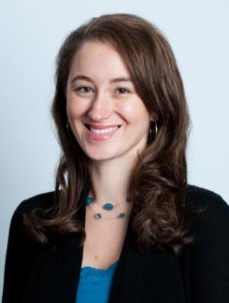
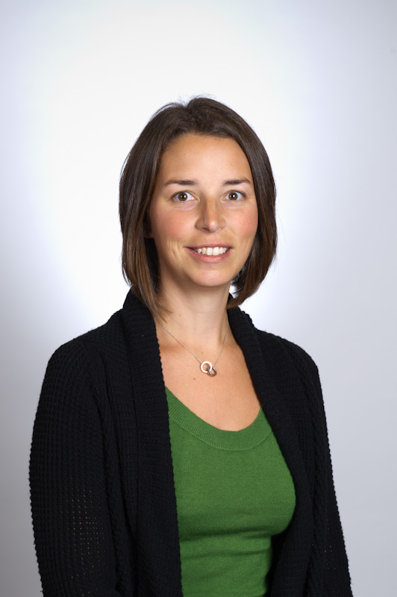
Contact Us
Saskatchewan Research Council
Mining and Energy Division
www.src.sk.ca/ceder
Erica Emery, P.Eng.
Senior Research Engineer
Process Development
Erica.Emery@src.sk.ca
306-564-3506
Dr. Erin Powell, P.Eng. Manager (On leave)
Process Development
Erin.Powell@src.sk.ca
306-385-4171
Lesley McGilp, P.Eng.
Acting Manager
Process Development
Lesley.Mcgilp@src.sk.ca
306-385-4167

